Slide 1



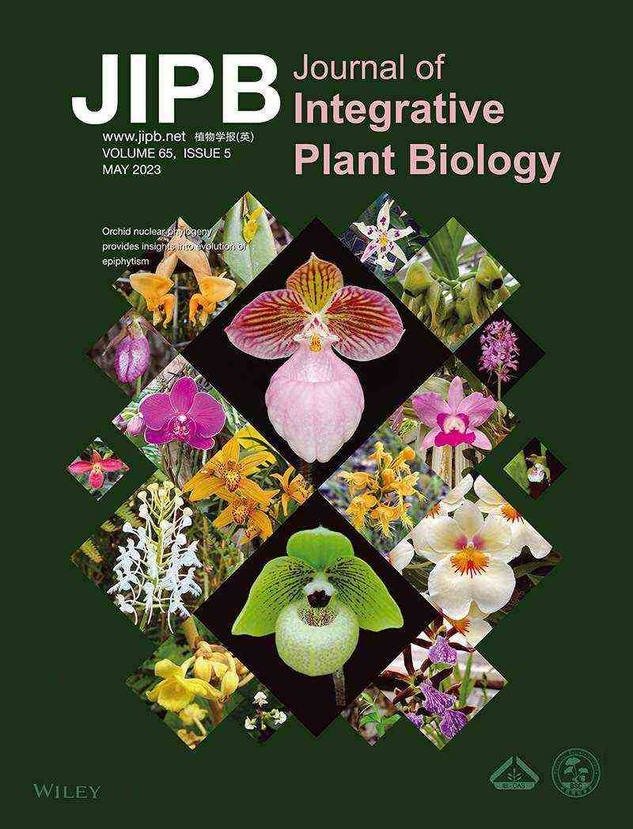
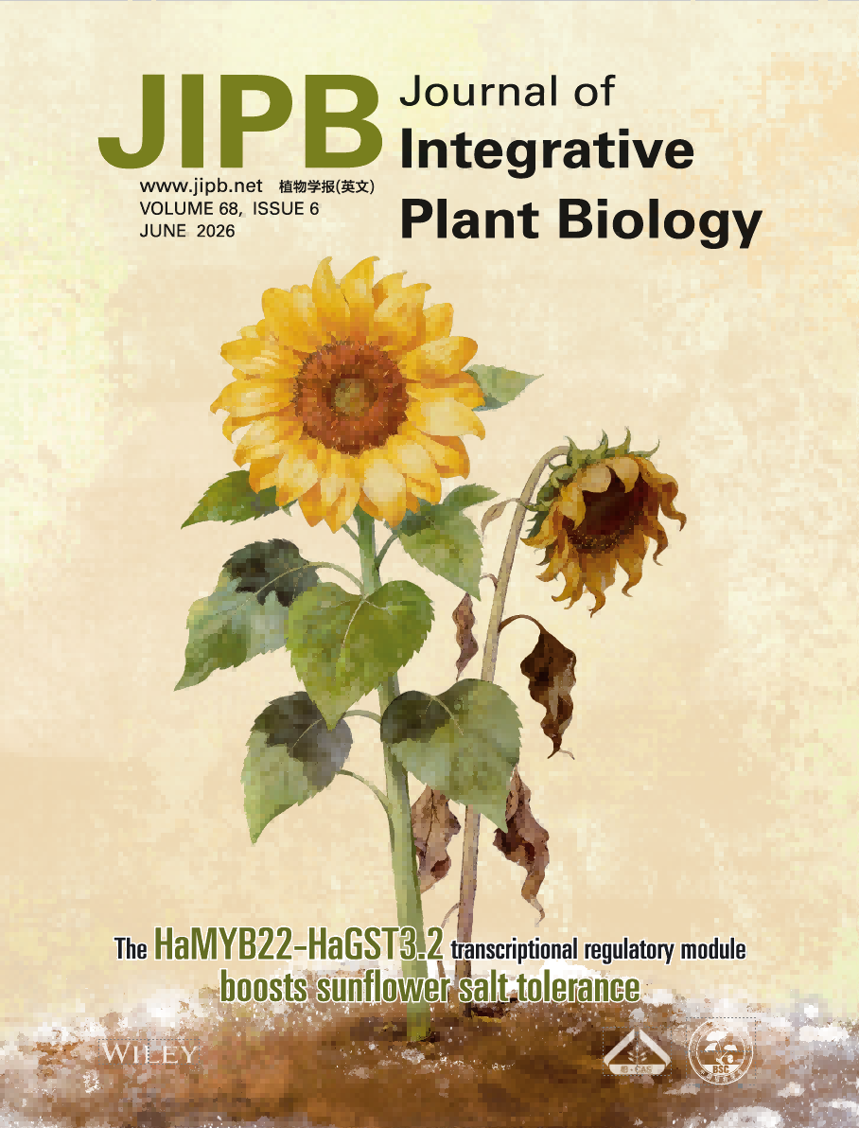
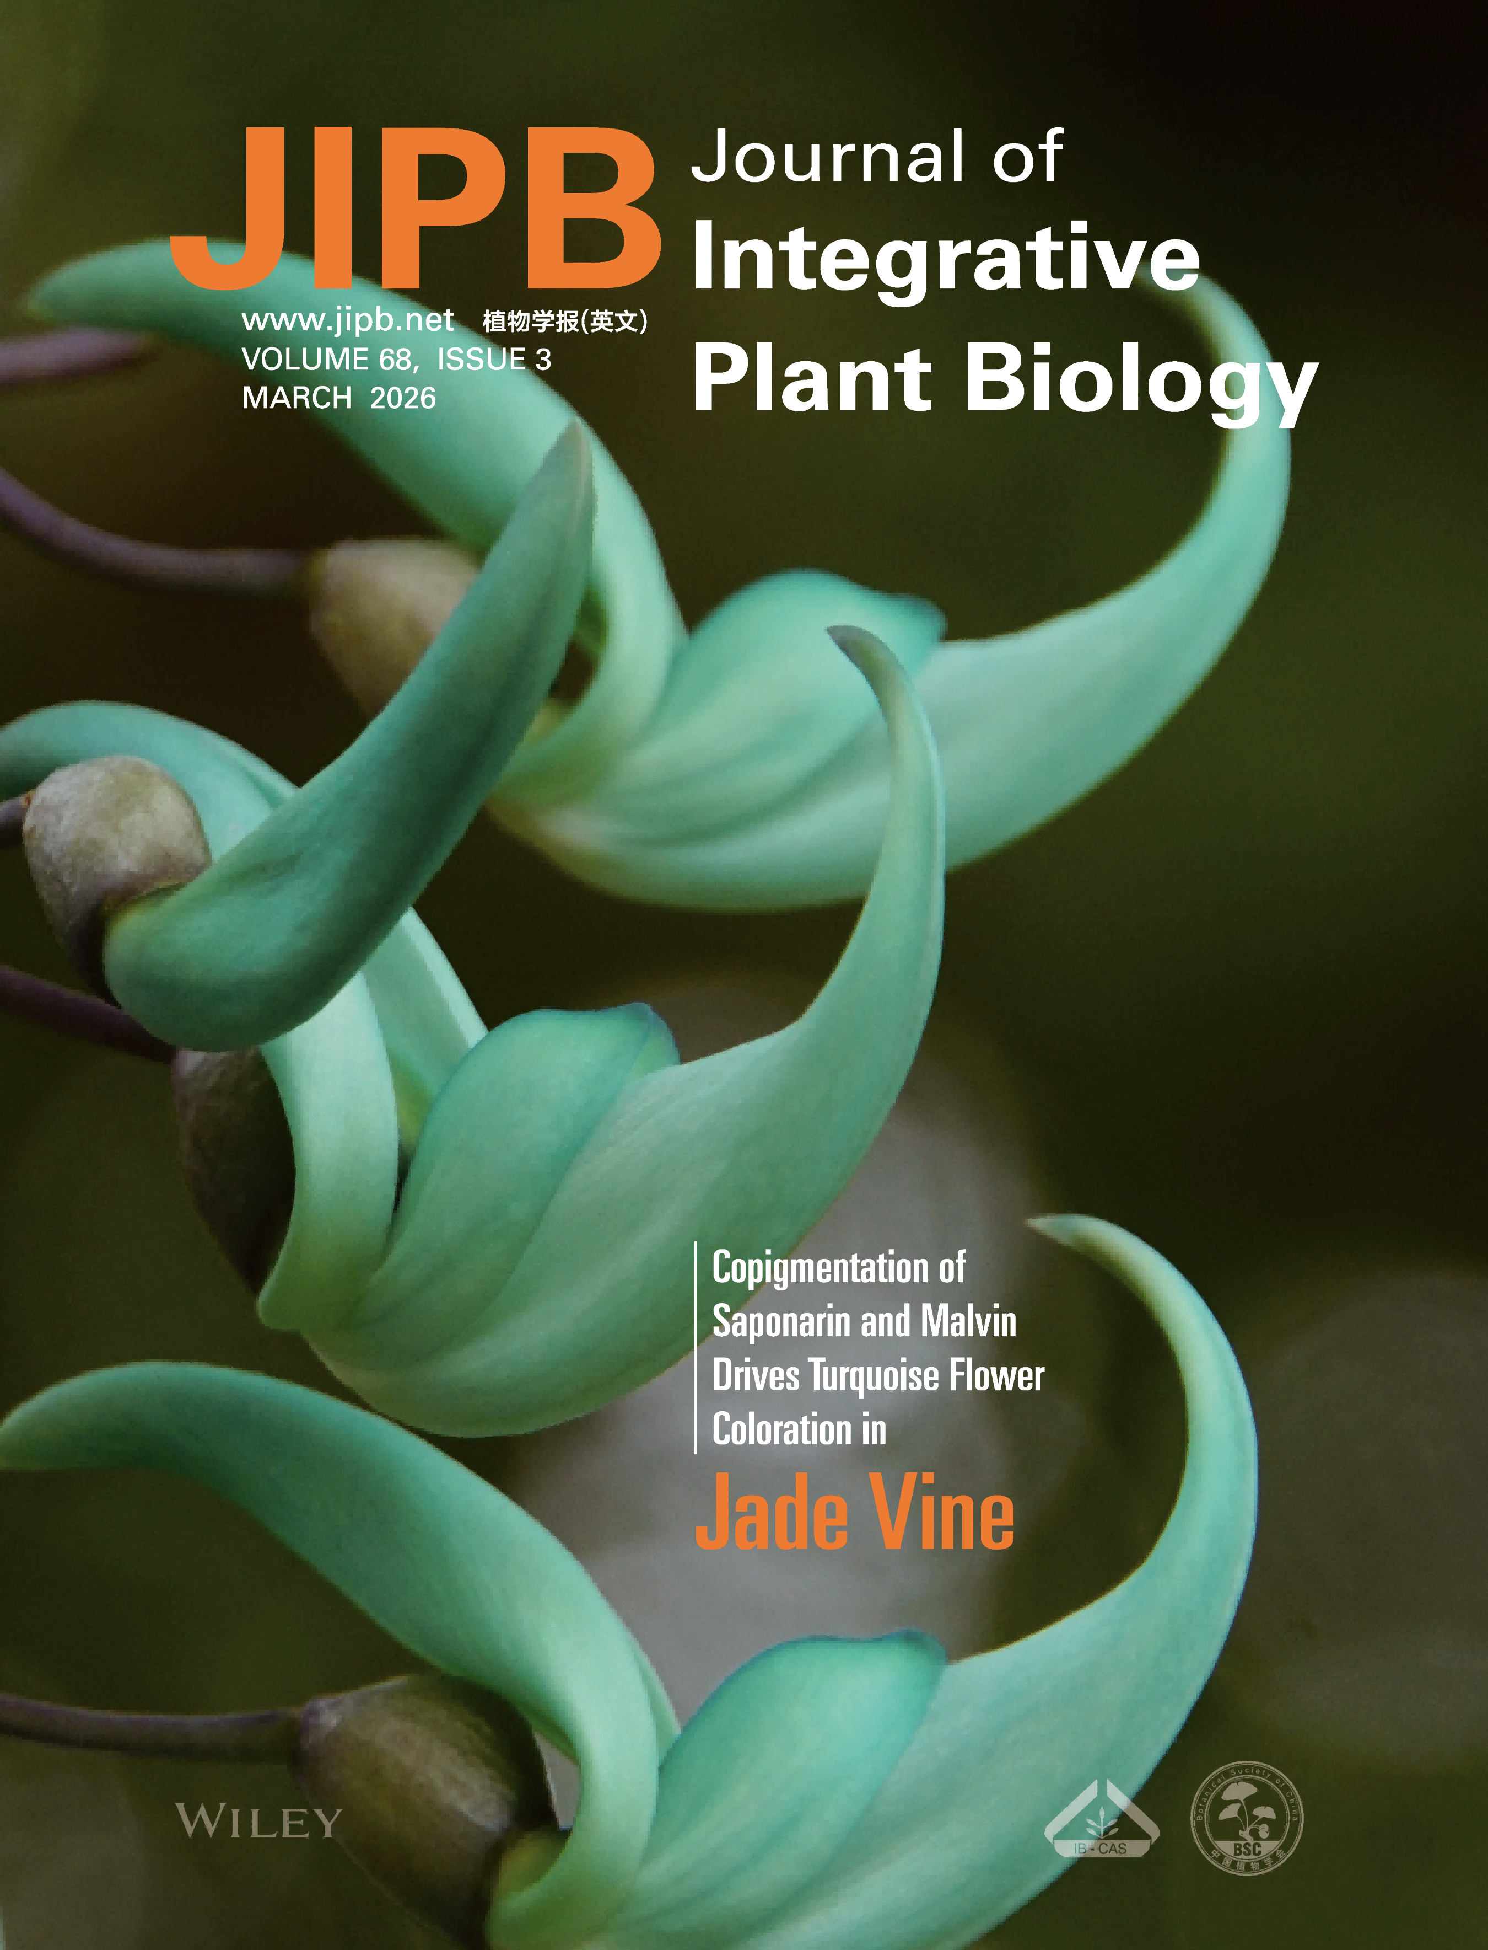
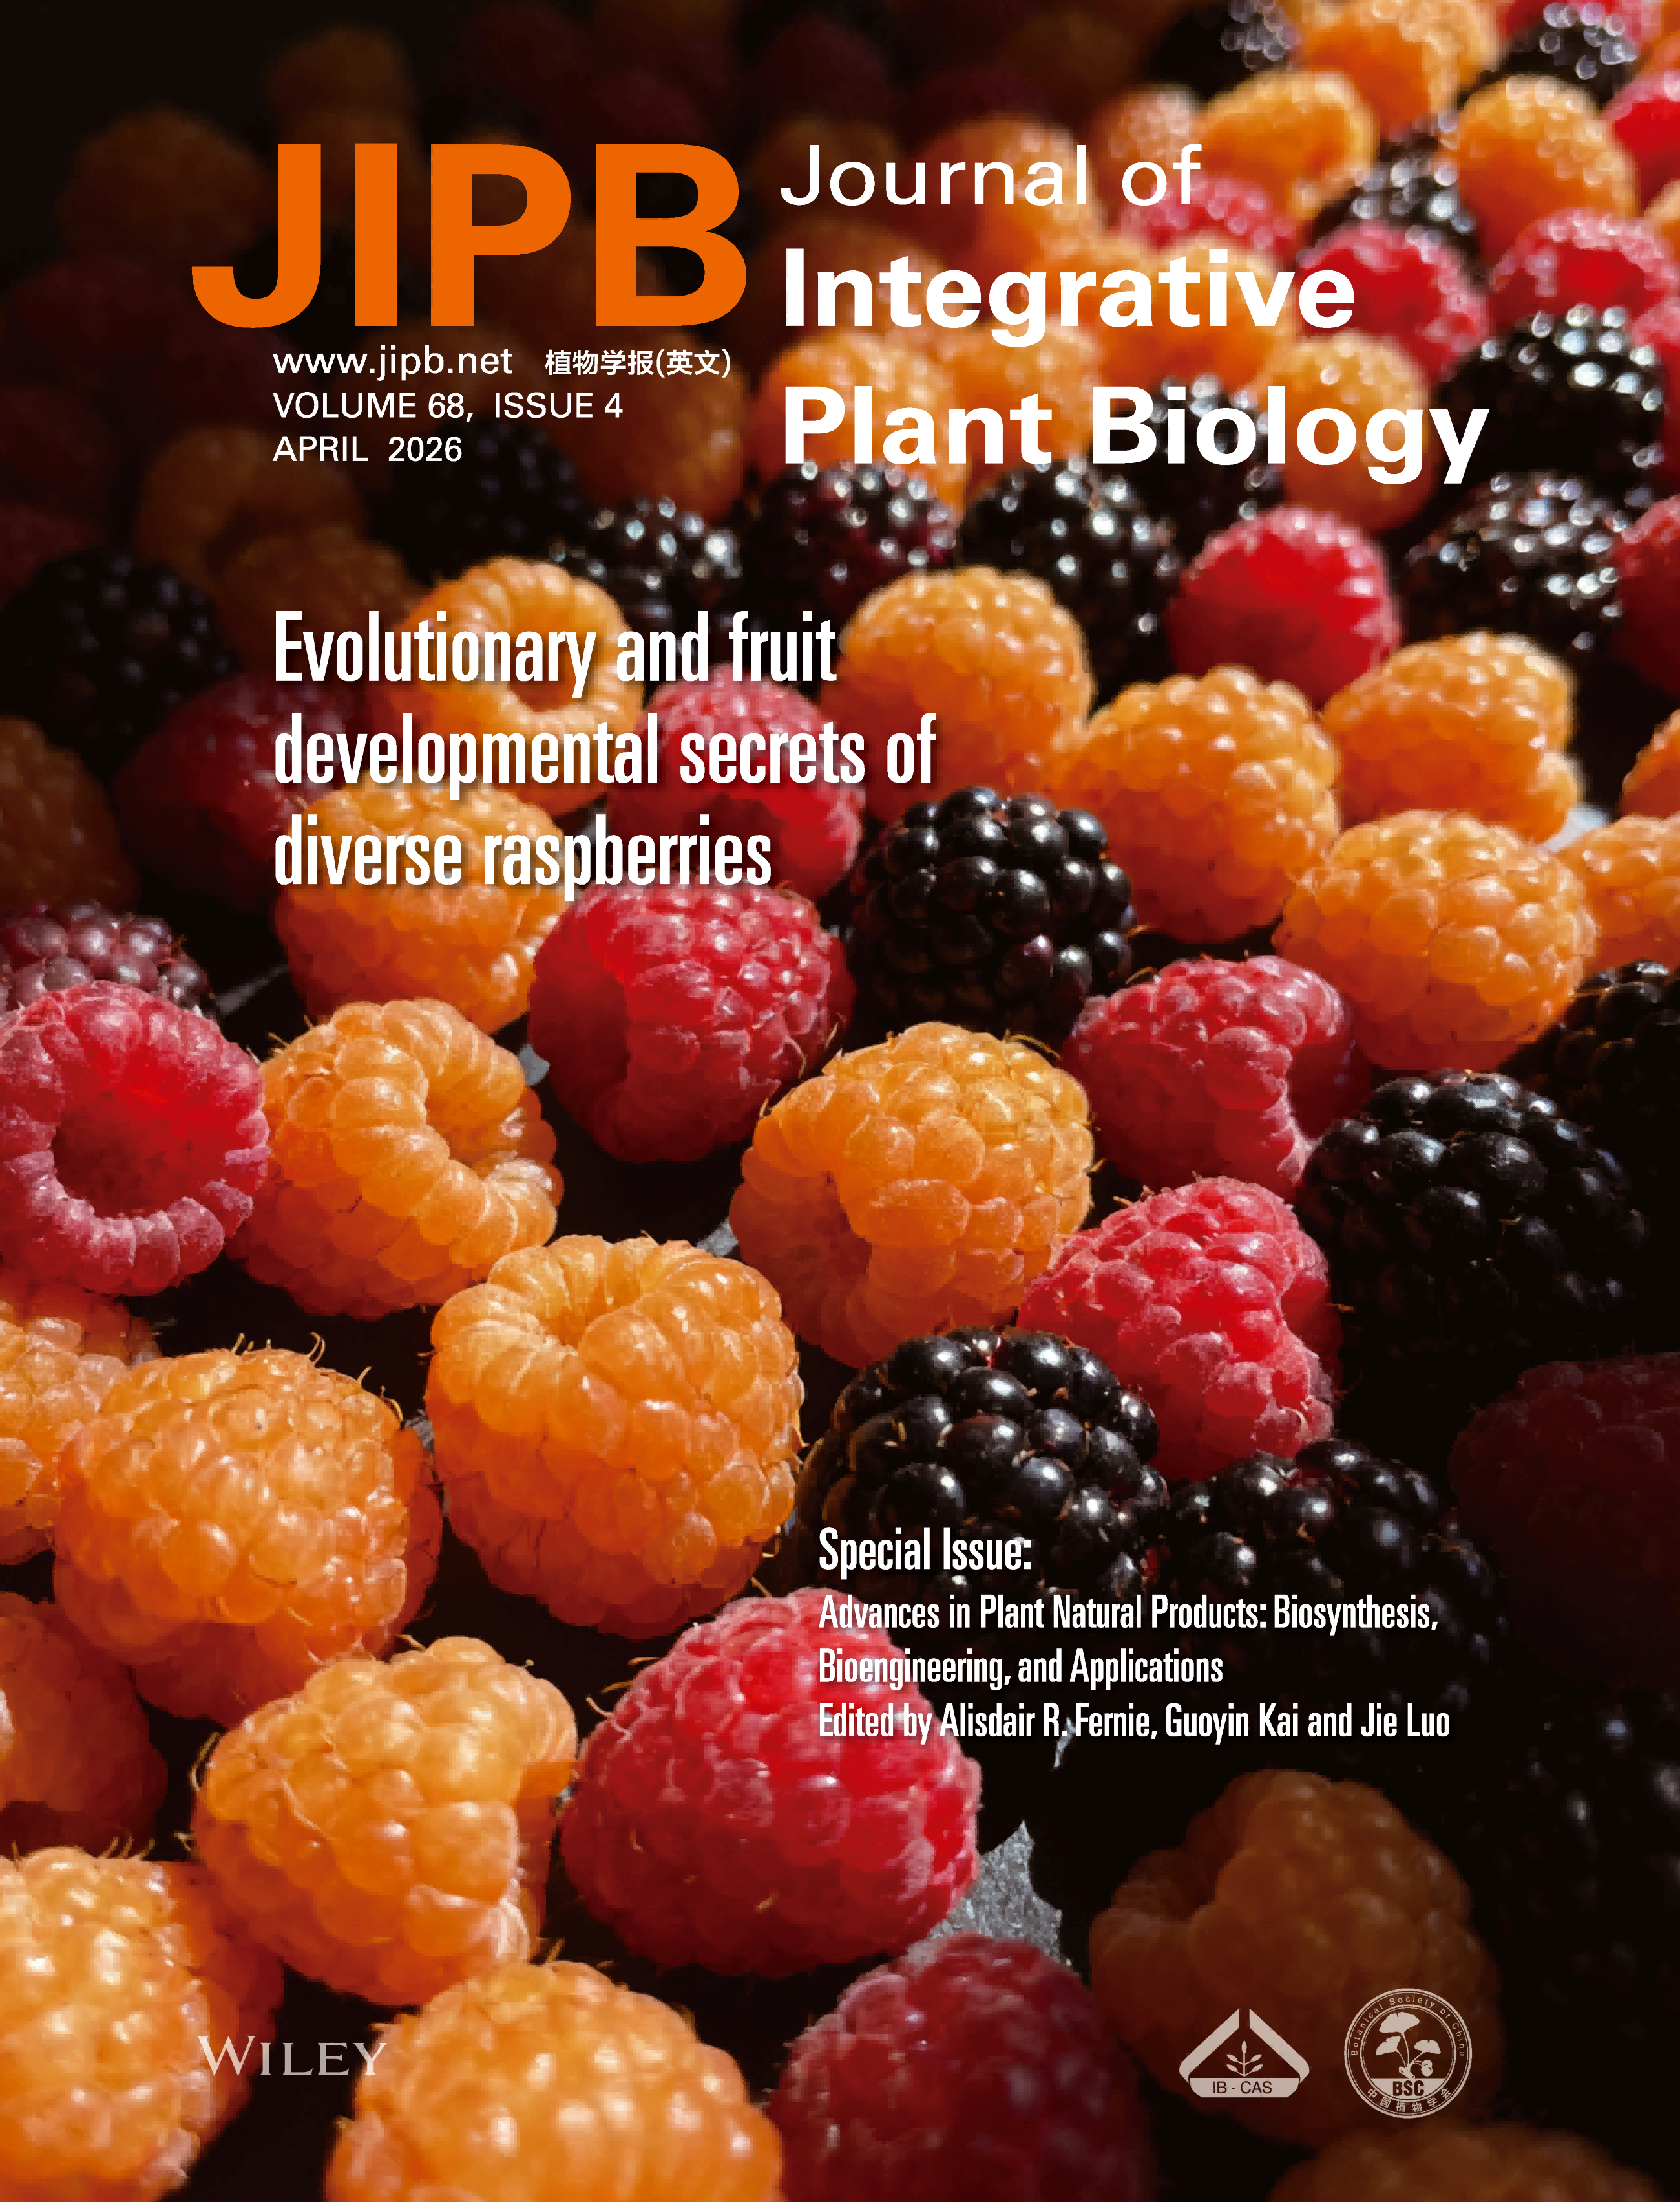
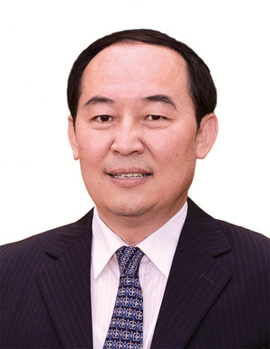

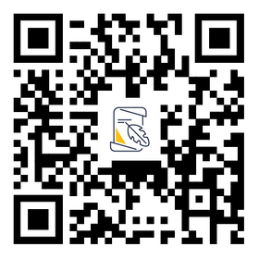
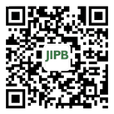
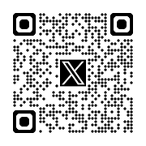
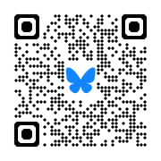
Co-Editors-in-Chief
Research Themes
Abiotic Stress Responses
Cell and Developmental Biology
Functional Omics and Systems Biology
Global Change Biology
Metabolism and Biochemistry
Molecular Ecology and Evolution
Molecular Physiology
Photosynthesis and Crop Physiology
Plant Biotic Interactions
Plant Reproductive Biology
Kang Chong
Zhizhong Gong
Institute of Botany, CAS, China
China Agricultural University, China
Aim and Scope
The journal seeks to foster communication and discussion among scientists from diverse areas of plant and agricultural sciences.
JIPB reports novel scientific discoveries of any aspects of plant biology, preferably but not exclusively using integrative genetic, genomic, biochemical, and systems biology approaches. Significant new technologies that have the potential to elucidate general plant biology questions may also be considered.
Journal Metrics
Article Categories
2025 JCR Impact Factor: 12.5
5-year Impact Factor: 13.8
Top 3% in Plant Sciences
CiteScore 2025: 18.3
Top 1% in Plant Science
Research Article
Review Article
Brief Communication
Commentary
Highlight
New Technique
Resources
News and Views
Publish with JIPB
Accessible from 85 databases: SCI, PubMed, Google Scholar, etc.
Rapid publication: Submission to first decision: 24 days; Submission to acceptance: 88 days.
Fast-Track Publication “PubExpress”: Decision in 3–5 days.
Publishing mode: OpenAccess or Subscription.
Contact JIPB
Email: jipb@ibcas.ac.cn
Tel: +86-010-62836133
Website: https://www.jipb.net
Manuscript Submission
WeChat: jipb1952
X: @JIPBio
Bluesky: jipb.bsky.social

